Slide 1
SPREADSHEET ANALYSIS IN PYTHON
GROUP 4
Sarah, Maria, Johanna, Katherine

Slide 2
Presentation Topics
SPREADSHEET ANALYSIS
GROUP 4
01.
What did you learn from the experience?
02.
Showcase your code and talk us through it + What did you learn from working within a team?
03.
What issues did you run into and how did you fix them?
04.
If you had more time, what would you have done differently?
05.
If you were to expand on the project, what additional features would
you add?

Slide 3
TASK REQUIREMENTS
SPREADSHEET ANALYSIS
GROUP 4
01.
Read the data from the spreadsheet
02.
Collect all of the sales from each month into a single list
03.
Output the total sales across all months

Slide 4
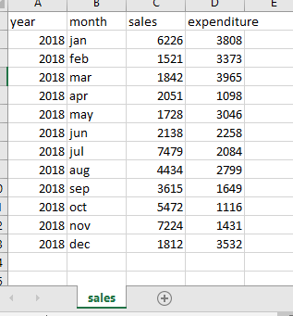
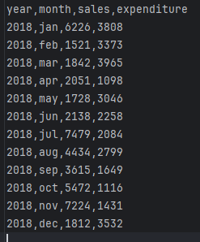
Original sales.csv File
SPREADSHEET ANALYSIS
GROUP 4
Opened in Excel:
Opened in PyCharm:

Slide 5
CODE FOR REQUIRED TASKS USING SALES.CSV
SPREADSHEET ANALYSIS
GROUP 4
Reading the data from the spreadsheet:
Showing the sales from each month in a single list:
import csv
def read_data():
data = []
with open('sales.csv', 'r') as sales_csv:
spreadsheet = csv.DictReader(sales_csv)
for row in spreadsheet:
data.append(row)
return data
def monthly_sales():
data = read_data()
for row in data:
print(f"Month: {row['month']}, Sales: {row['sales']}")
monthly_sales()
Outputting the total sales across all months:
def total_sales():
data = read_data()
sales = [int(row['sales']) for row in data]
total = sum(sales)
print(f'Total sales: {total}')
return total
total_sales()
Notes:
Read data function: reading and looping over csv file, adding a list to the data variable
Total sales: using the read_data() function, looping over sales column and storing values in a list, summing the values in the list. Added list comprehension making the code more concise.
Monthly sales: using the read_data() function, looping over the data and outputting month and sales values

Slide 6
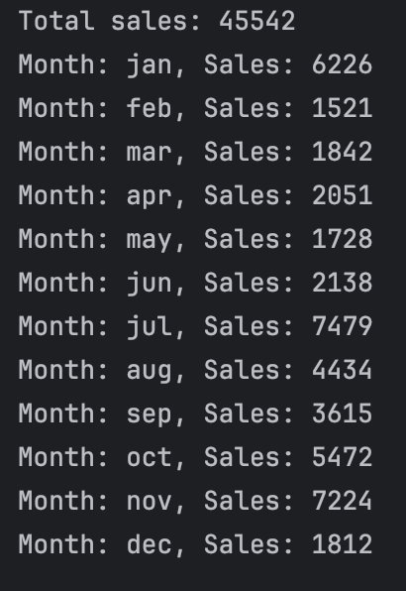
OUTPUT PRINTED FOR REQUIRED TASKS USING SALES.CSV
SPREADSHEET ANALYSIS
GROUP 4
Total sales: 45542
Month: jan, Sales: 6226
Month: feb, Sales: 1521
Month: mar, Sales: 1842
Month: apr, Sales: 2051
Month: may, Sales: 1728
Month: jun, Sales: 2138
Month: jul, Sales: 7479
Month: aug, Sales: 4434
Month: sep, Sales: 3615
Month: oct, Sales: 5472
Month: nov, Sales: 7224
Month: dec, Sales: 1812

Slide 7
CODE EXTENSIONS USING SALES.CSV
SPREADSHEET ANALYSIS
GROUP 4
Percentage Difference by Inputting Two Dates:
def percentage_difference():
data = read_data()
sales_by_month = {row['month'].lower(): int(row['sales']) for row in data}
month1 = input("Enter a month (e.g., jan): ").lower()
month2 = input("Enter another month you want to compare the first months sales against (e.g., feb): ").lower()
sales1 = sales_by_month[month1]
sales2 = sales_by_month[month2]
percentage_difference = round(((sales2 - sales1) / sales1) * 100,2)
print(f"Sales in {month1}: {sales1}")
print(f"Sales in {month2}: {sales2}")
print(f"Percentage difference in sales between {month1} and {month2}: {percentage_difference}%")
percentage_difference()
def change_percent():
data = read_data()
sales = [int(row['sales']) for row in data]
for i in range(len(sales)-1):
old = sales[i]
new = sales[i+1]
percent_change = round(((new - old) / old) * 100,2)
print(f"% change: {percent_change} %")
change_percent()
Print Month on Month Percentage Differences:
Notes:
We started by exploring the extensions suggested on the project brief so we could test our knowledge of them and get to grips fully with the csv file
This included exploring two ways of percentage difference (1. Using input so a user could just two months to compare & 2. Printing the month on month percentage change)

Slide 8
CODE EXTENSIONS USING SALES.CSV
SPREADSHEET ANALYSIS
GROUP 4
Average Sales
Highest Sales Figure
def avg_sales1():
data = read_data()
sales = [int(row['sales']) for row in data]
AVG = round(sum(sales)/len(sales),2)
print(f'Average sales: {AVG}')
return AVG
avg_sales1()
def highest_sale():
data = read_data()
sales = [int(row['sales']) for row in data]
highest_sales = max(sales)
print(f"Highest sales figure: {highest_sales}")
return highest_sales
highest_sale()
def avg_sales2():
from statistics import mean
data = read_data()
sales = [int(row['sales']) for row in data]
avg = round(mean(sales),2)
print(f"Average: {avg}")
avg_sales2()
Lowest Sales Figure
def lowest_sale():
data = read_data()
sales =[int(row['sales']) for row in data]
lowest = min(sales)
print(f"Lowest sales figure: {lowest}")
return lowest
lowest_sale()
Notes:
Average Sales: Option 1) using sum() and len () functions. Option 2) importing mean from the statistics module (saving the list using list comprehension)
Highest Sales: max()
Lowest Sales: min()

Slide 9
OUTPUT PRINTED FOR EXTENSION TASKS USING SALES.CSV
SPREADSHEET ANALYSIS
GROUP 4
Enter a month (e.g., jan): jan
Enter another month you want to compare the first months sales against (e.g., feb): feb
Sales in jan: 6226
Sales in feb: 1521
Percentage difference in sales between jan and feb: -75.57%
% change : -75.57 %
% change : 21.1 %
% change : 11.35 %
% change : -15.75 %
% change : 23.73 %
% change : 249.81 %
% change : -40.71 %
% change : -18.47 %
% change : 51.37 %
% change : 32.02 %
% change : -74.92 %
Average sales: 3795.17
Highest sales figure: 7479
Lowest sales figure: 1521
Notes:
Output for Percentage Difference by Inputting Two Dates
Output for Print Month on Month Percentage Differences
Output for the average, hughes and lowest functions

Slide 10
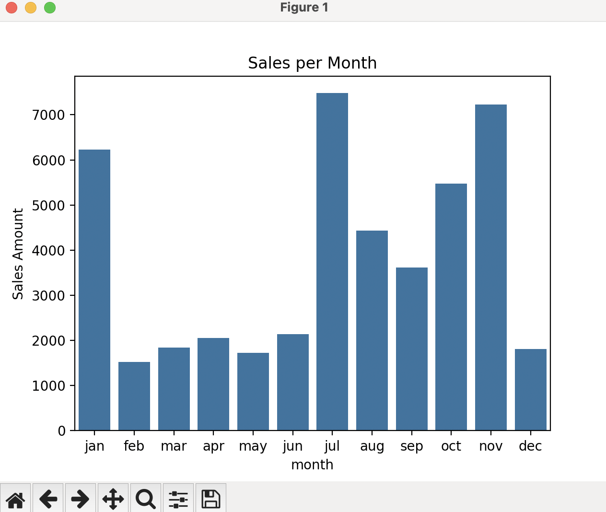
CODE EXTENSIONS USING SALES.CSV
SPREADSHEET ANALYSIS
GROUP 4
Seaborn
Using Seaborn we could print the csv file into a graph (in this case a bar chart) and read the data in a different format using the code below:
import seaborn as sns
import matplotlib.pyplot as plt
import pandas as pd
data = pd.read_csv("sales.csv")
sns.barplot(data = data, x="month", y="sales")
plt.title("Sales per Month")
plt.xlabel("month")
plt.ylabel("Sales Amount")
plt.show()
Notes:
Lots of example data sets available to experiment with (tips = sns.load_dataset("tips"))
Variety of graph types available: Scatter graph, histogram, line plots etc. sns.barplot(), sns.scatterplot(), sns.lineplot()
For Pycharm need to import matplotlib.pyplot as plt (this was not necessary for google colab)
In order to read our data, needed to import pandas and create the data variable to read the csv file.
Lots more exploration and customisation can be done in Seaborn - hue, size, stylet etc added to this line of code: sns.barplot(data = data, x="month", y="sales")

Slide 11
CODE EXTENSIONS USING SALES.CSV
SPREADSHEET ANALYSIS
GROUP 4
Outputting summary of results to Excel
def monthly_sales():
data = read_data()
for row in data:
print(f"Month: {row['month']}, Sales: {row['sales']}")
monthly_sales()
def monthly_sales():
data = read_data()
monthly_output = []
for row in data:
output = {'Month':row['month'],'Sales':row['sales']}
monthly_output.append(output)
# print(monthly_output)
return monthly_output
monthly_sales()
monthly_sales() updated to
Summary variable created
summary = {
'Summary' :['Average Sales', 'Highest Sale', 'Lowest Sale', 'Total Sales'],
'Result' : [avg_sales1(), highest_sale(), lowest_sale(), total_sales()]
}
Notes:
Exporting monthly sales & AVG, Highest, lowest and total sales values to Excel
All functions need to return a value
Working with dictionaries and lists
monthly_sales: monthly_output variable added to store a list of dictionaries & output updated to store each iteration as a dictionary and output appended.
Created dictionary summary calling our functions and saving them in a dictionary

Slide 12
OUTPUT PRINTED FOR EXTENSION TASKS USING SALES.CSV
SPREADSHEET ANALYSIS
GROUP 4
import pandas as pd
dataset1 = monthly_sales()
dataset2 = summary
df1 = pd.DataFrame(dataset1)
df2 = pd.DataFrame(dataset2)
with pd.ExcelWriter('Python_Project_x2.xlsx') as writer:
df1.to_excel(writer, sheet_name='Monthly_Sales')
df2.to_excel(writer, sheet_name='Summary')
Notes:
Import pandas & show dataset variables
Create dataframe(s) (df) - Here we have df1 & df2, where pd calls panda module, then DataFrame() is how you insert your data into a Dataframe
We will have 2 tabs on the spreadsheet so using Excel Writer as writer - and naming the file .xlsx
Then user to_excel() function, stating writer, then input the sheet name
When this is run the file will appear on the right hand side of Pycharm and can be opened.

Slide 13
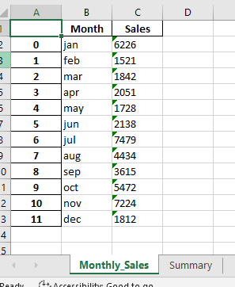
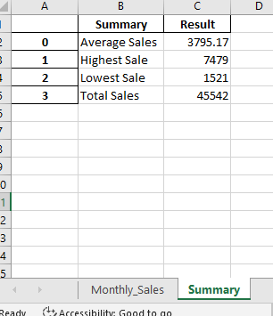
OUTPUT PRINTED FOR EXTENSION TASKS USING SALES.CSV
SPREADSHEET ANALYSIS
GROUP 4
Notes:
Output

Slide 14
WHAT DID WE LEARN FROM WORKING WITH A TEAM?
SPREADSHEET ANALYSIS
GROUP 4
The different ways other people approach the same piece of code
It’s handy to have a second pair of eyes for troubleshooting, to check code, and to find different solutions to the same problem!

Slide 15
WHAT DID WE LEARN FROM THE EXPERIENCE?
SPREADSHEET ANALYSIS
GROUP 4
That there are lots of different ways to reach the same end result, and there isn’t necessarily one perfect way.
Keep it simple! We went back to the original CSV file in the end because it helped focus us on the Must Have elements and we then also had the capacity to explore different types of code.

Slide 16
WHAT ISSUES DID WE RUN INTO AND HOW DID WE FIX THEM?
SPREADSHEET ANALYSIS
GROUP 4
Some pieces of code didn’t work the way we thought they might, so we had to troubleshoot and work out why they didn’t work. Asking other people in the group for help resolved quite a of few of these issues!
When using a larger dataset, code to manipulate the dataset worked for some of us but not for others
Lots of google and Youtube

Slide 17
IF YOU HAD MORE TIME, WHAT WOULD YOU HAVE DONE DIFFERENTLY?
SPREADSHEET ANALYSIS
GROUP 4
Maybe divided the code up sooner, although with it being our first time doing this it was hard to know what the best way of doing this was.
We would have liked to have worked more on manipulating larger datasets
Notes:
Figure out how to import all data into excel

Slide 18
IF YOU WERE TO EXPAND ON THE PROJECT, WHAT ADDITIONAL FEATURES WOULD YOU ADD?
SPREADSHEET ANALYSIS
GROUP 4
Tried learning some new things that we could add to our code. Seaborn and Excel were great extensions (thanks, Sarah!) and I would have loved to have added more if there was more time to read up on other things we could do with the data.
Try out our code on a different/larger dataset.

Slide 19
THANKS
SPREADSHEET ANALYSIS
GROUP 4

